Slide 1


Evan Alter
May 2023

Slide 2

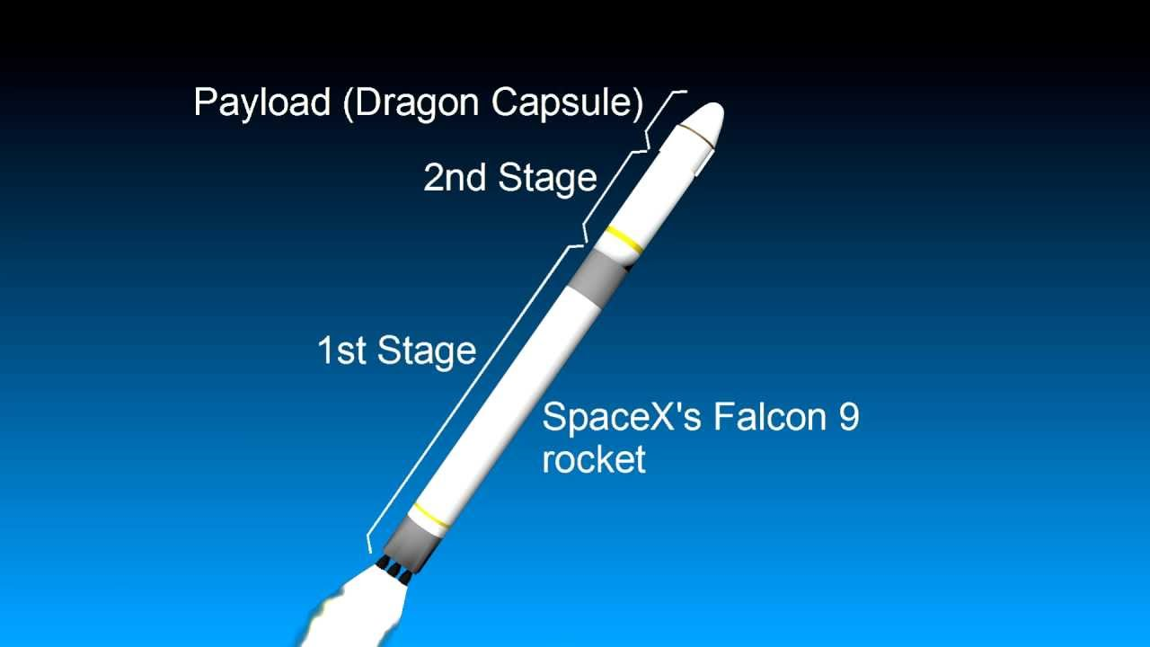
Outline
Executive Summary
Introduction
Methodology
Results
Conclusion
Appendix

Slide 3
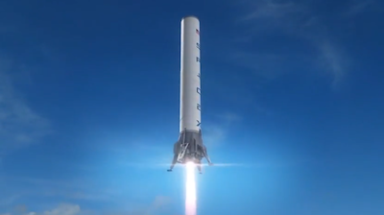
Executive Summary
Overview
This analysis seeks to identify models that can be used to predict the successful return of the first stage of rockets. This can be used to plan profitability for Space Y as it emerges onto the market.
Summary of methodologies
SpaceX REST API call and Web Scraping from Wikipedia with Beautiful Soup were used to collect data. The data was then cleaned and wrangled for Exploratory Data Analysis using Visualization and SQL. Next interactive visual analytics were performed using Folium Map and Plotly Dash. Lastly predictive analysis was performed using classification models (Logistic Regression, Support Vector Machine, Decision Tree, K Nearest Neighbor).
Summary of all results
The Falcon 9 stage 1 has an overall successful return landing rate of 67%, but that varies greatly by launch site, booster version, orbit, and payload mass. The success rate trend has been improving from 2013-2020, and has reached 90% in 2019 and 84% 2020.
The Decision Tree method is the best option for predicting success rates. It had an R2 score of 89% in training and 83% in testing. The 3 other methods (Logistic Regression, Support Vector Machine, and K Nearest Neighbor) all performed similarly with a training R2 of 85% and testing R2 of 83%.
https://github.com/ealter19/Applied-Data-Science-Capstone
Notes:
Summary of methodologies
Summary of all results

Slide 4
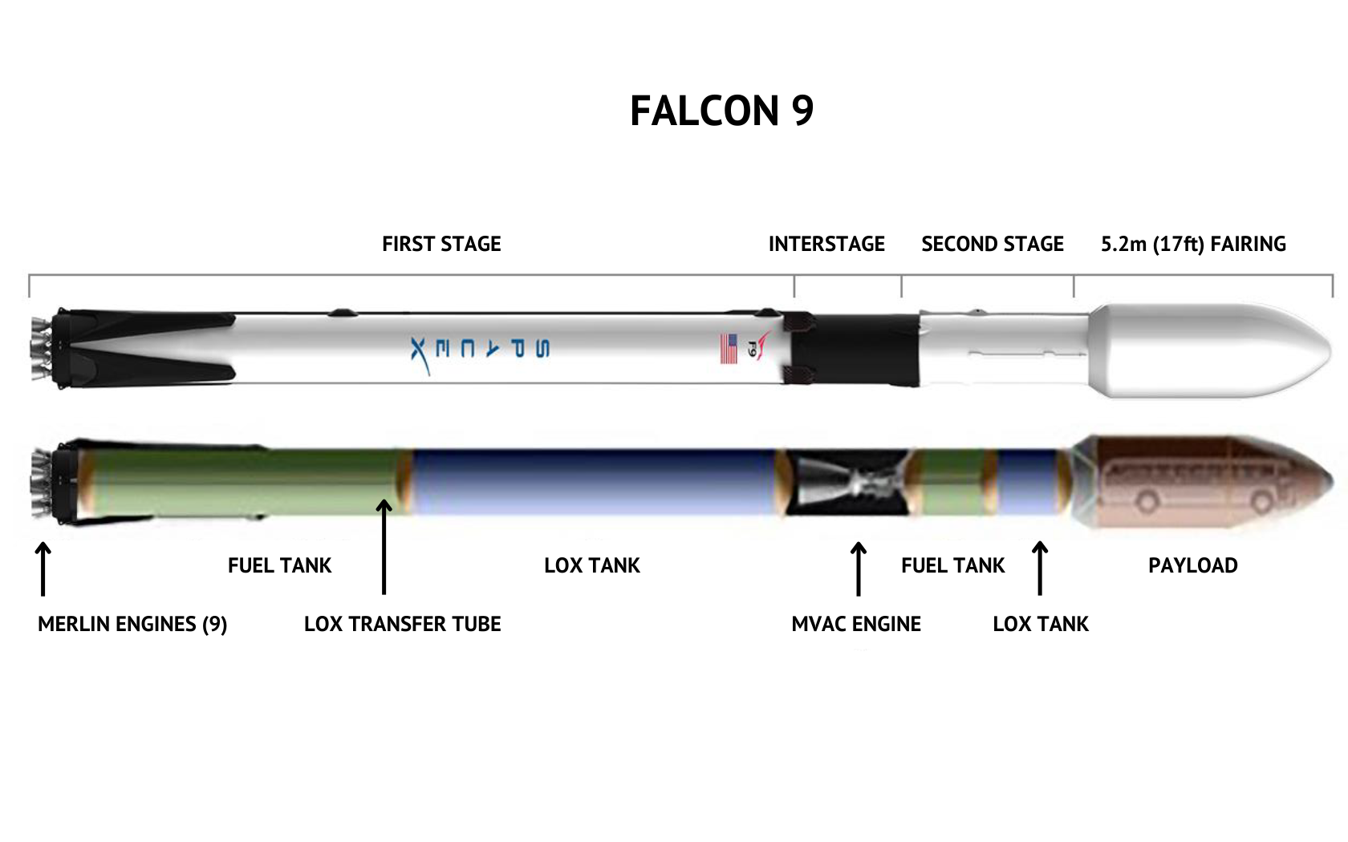
Introduction
Project Background and context
Space Y is a new rocket company seeking to compete with Space X
Space Y needs to analyze the success of Space X to understand its challenges
The Falcon 9 is a Space X rocket that consists of two stages and a fairings.
Stage 1 is the lower portion of the Faclon 9 and has engines that launch it off the launch pad and into the upper atmosphere, where it disconnects from the rest of the rocket.
Stage 2 is in the middle of the rocket and has its own engines that fire after Stage 1 separates in order to position the payload in the necessary orbit around Earth. It then disconnects.
The fairings is the capsule at the top of the rocket that contains and protects the payload (e.g. satellites), and releases it into orbit when in the correct position.
Space X is unique in the space industry because Stage 1 is capable of returning to Earth for reuse in future missions. This can save a significant amount of money and increase Space X’s profitability.
In this analysis we will examine the success rates of Falcon 9’s Stage 1 safe return to Earth. We will build models to predict success rates based off of numerous factors.
These results will help Space Y business leaders decide how to best set up their business for success.
Problems to answer
What are the Falcon 9 success rates under various conditions (payload mass, launch site, orbit, etc)?
What models can best predict Falcon 9 successful relandings?
GitHub Repository Link
Notes:
Project background and context
Problems you want to find answers

Slide 5
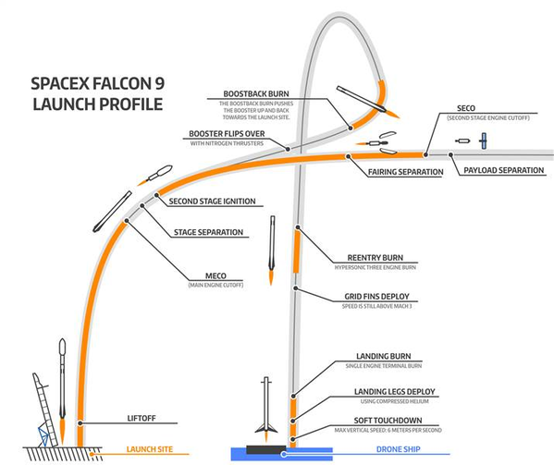
Introduction – Falcon 9 Stages Visual
Key phases in the launch-and-landing plan for SpaceX Falcon 9 rocket. Image credit: Jon Ross, NBC News.com
Notes:
Project background and context
Problems you want to find answers

Slide 6

Section 1

Slide 7
Methodology
Executive Summary
Data collection methodology:
SpaceX REST API
Web Scrapping from Wikipedia
Perform data wrangling
Dropping unnecessary columns
One Hot Encoding for classification models
Perform exploratory data analysis (EDA) using visualization and SQL
Perform interactive visual analytics using Folium and Plotly Dash
Perform predictive analysis using classification models
How to build, tune, evaluate classification models

Slide 8
Data Collection
Publicly available information on Space X’s Falcon 9 program was collected from 2 sources:
SpaceX REST API (https://api.spacexdata.com/v4/)
Web Scraping html tables from Wikipedia.org
SpaceX REST API call with get request
API returns JSON response
Convert JSON to normalized Dataframe
Clean Data and Export
Get HTML Response from Wikipedia
Parse data with Beautiful Soup
Convert to Dataframe
Clean Data and Export
Notes:
Describe how data sets were collected.
You need to present your data collection process use key phrases and flowcharts

Slide 9
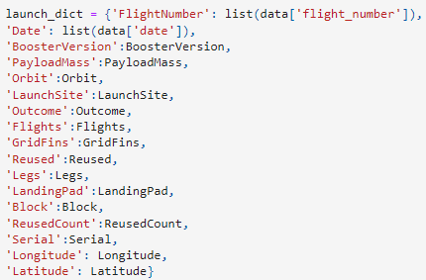
Data Collection – SpaceX API
1. SpaceX REST API Call
4. Construct dataset by coimbining columns into a dictionary
5. Create Dataframe
2. Convert reponse to JSON file and create Dataframe
6. Filter Dataframe to include only Falcon 9, reset Flight Number
3. Apply custom functions to clean the data
7. Replace missing PayloadMass values with the mean
8. Export to CSV file
GitHub URL of completed SpaceX API calls notebook
Notes:
Present your data collection with SpaceX REST calls using key phrases and flowcharts
Add the GitHub URL of the completed SpaceX API calls notebook (must include completed code cell and outcome cell), as an external reference and peer-review purpose

Slide 10
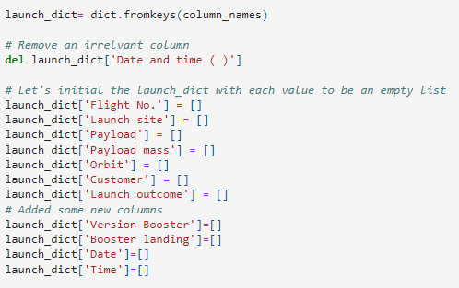
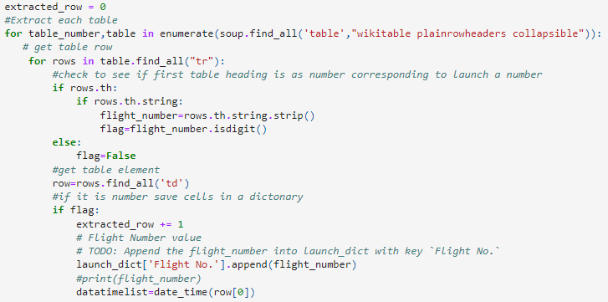
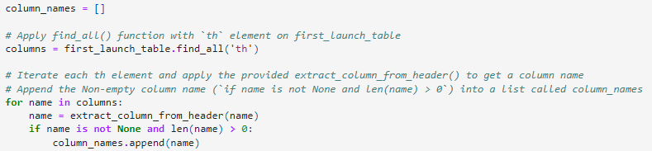
Data Collection - Scraping
1. Request HTTP Response
5. Create dictionary
6. Add data to keys
2. Parse Data with Beautiful Soup
3. Find all tables, select relevant table
Refer to notebook for remainder of code
4. Extract column names
7. Create Dataframe
8. Export to CSV
GitHub URL of completed web scraping notebook

Slide 11
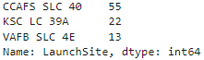
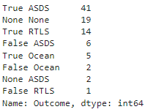
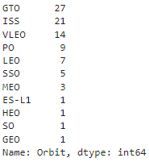
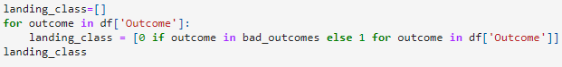
Data Wrangling
Goal: Transform string variables into binary categorical values where 1 = success and 0 = failure
1. Calculate number of launches on each site
3. Calculate number and occurrence of mission outcome per orbit type
2. Calculate number and occurrence of each orbit
6. Export to file
4. Create outcomes lists
5. Create a landing outcome label from outcome column
GitHub URL of completed data wrangling notebook
Notes:
Describe how data were processed
You need to present your data wrangling process using key phrases and flowcharts
Add the GitHub URL of your completed data wrangling related notebooks, as an external reference and peer-review purpose

Slide 12
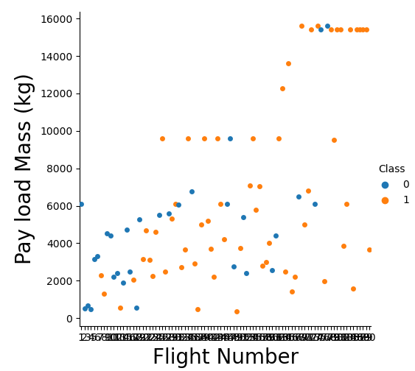
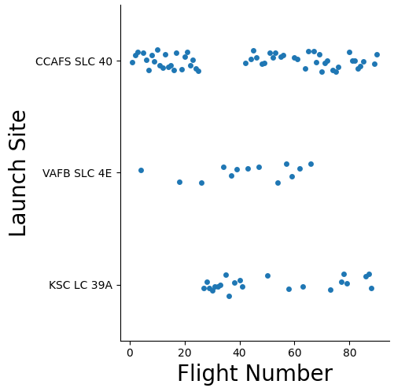
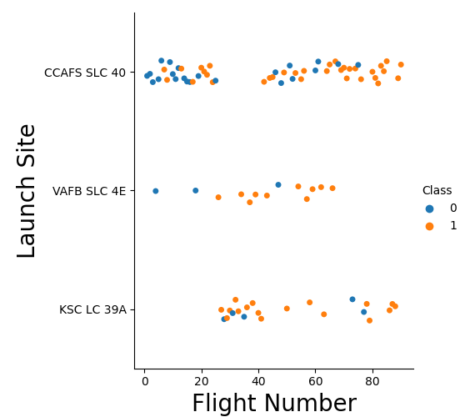
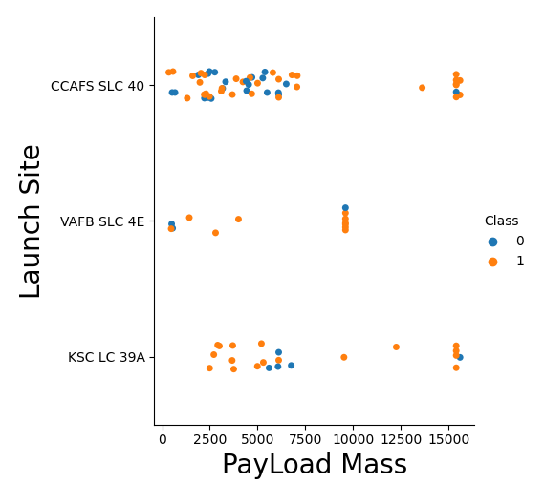
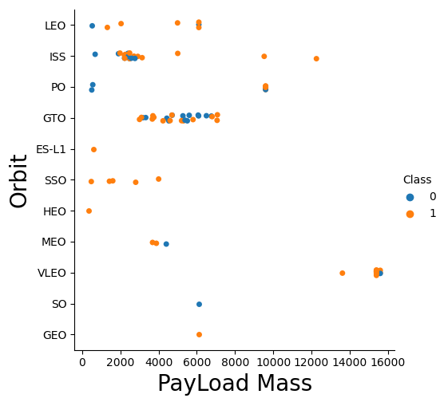
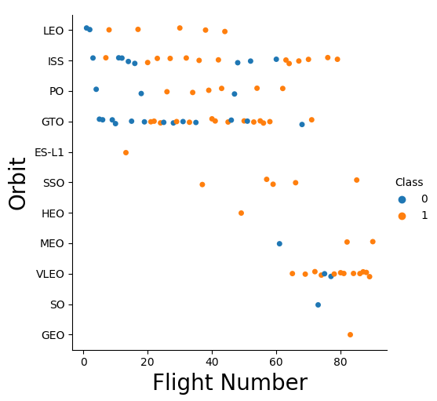
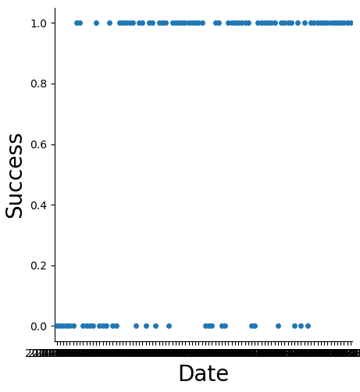
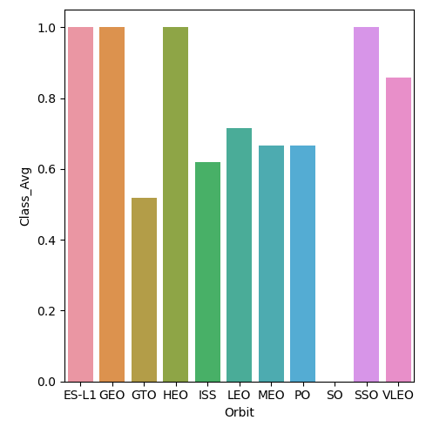
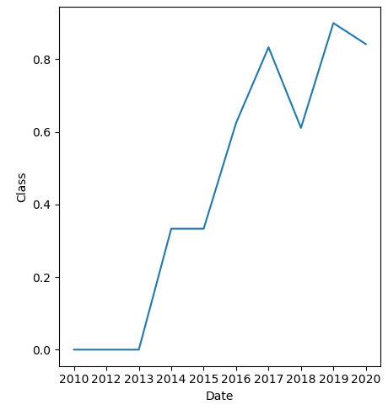
EDA with Data Visualization
Scatter Graphs (visualize patterns and correlations between numeric variables)
Bar Graphs (visualize relationship between numeric and categorical variables)
Line Graphs (visualize trend of numeric data over time)
GitHub URL of completed EDA with data visualization notebook
Notes:
Summarize what charts were plotted and why you used those charts
Add the GitHub URL of your completed EDA with data visualization notebook, as an external reference and peer-review purpose

Slide 13
EDA with SQL
SQL queries performed:
Display the names of the unique launch sites in the space mission
Display 5 records where launch sites begin with the string 'CCA‘
Display the total payload mass carried by boosters launched by NASA (CRS)
Display average payload mass carried by booster version F9 v1.1
List the date when the first successful landing outcome in ground pad was acheived.
List the names of the boosters which have success in drone ship and have payload mass greater than 4000 but less than 6000
List the total number of successful and failure mission outcomes
List the names of the booster_versions which have carried the maximum payload mass. Use a subquery
List the failed landing_outcomes in drone ship, their booster versions, and launch site names for in year 2015
Rank the count of landing outcomes between the date 2010-06-04 and 2017-03-20, in descending order
GitHub URL of completed EDA with SQL notebook

Slide 14
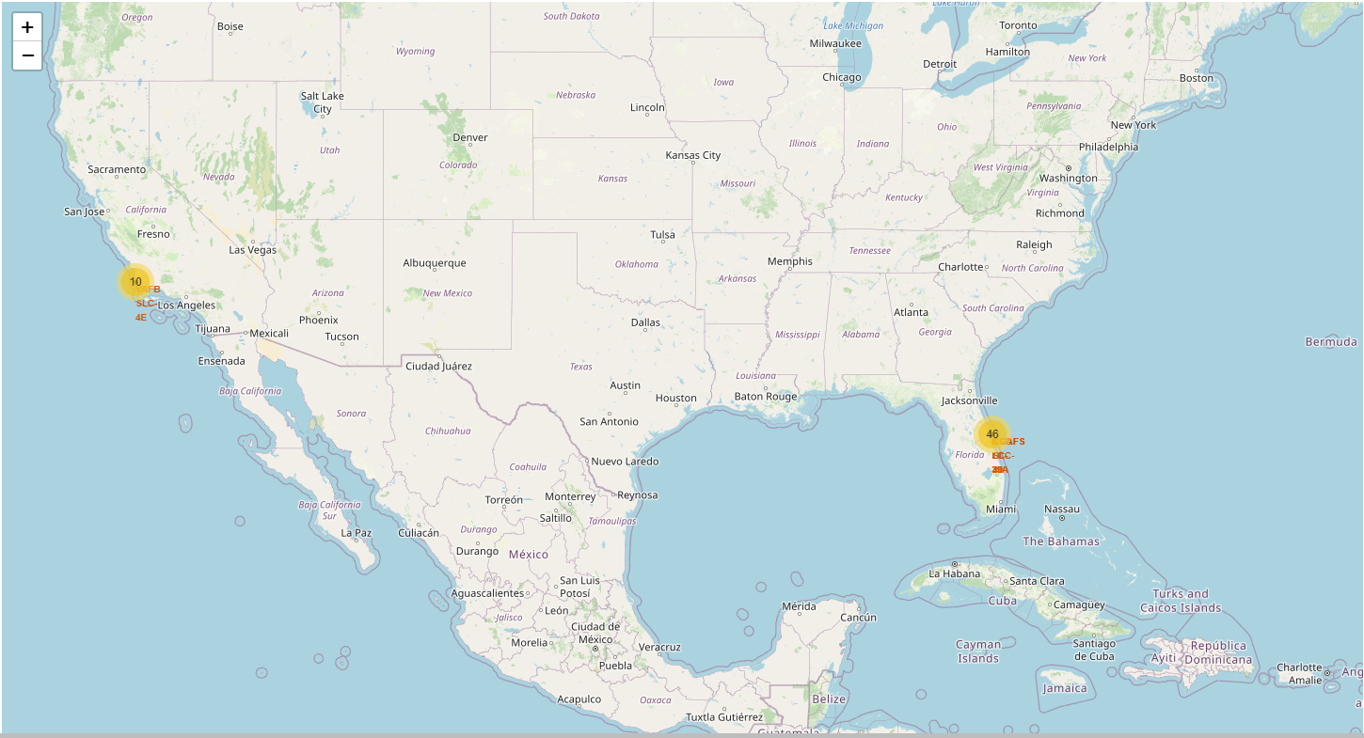
Build an Interactive Map with Folium
Folium Map Objects created:
Circles: created a red circle at NASA Johnson Space center and created a red circle at each Launch Site using Latitude and Longitude
Markers: created markers for each launch and color coded them based on success/failure (green/red). Displayed popup with Launch Site names. Grouped markers in cluster when launches occurred at the same location.
Lines: Drew a line between a launch site and the coast to determine distance from the coast to the launch site
GitHub URL of completed interactive map with Folium map
Notes:
Summarize what map objects such as markers, circles, lines, etc. you created and added to a folium map
Explain why you added those objects
Add the, as an external reference and peer-review purpose

Slide 15
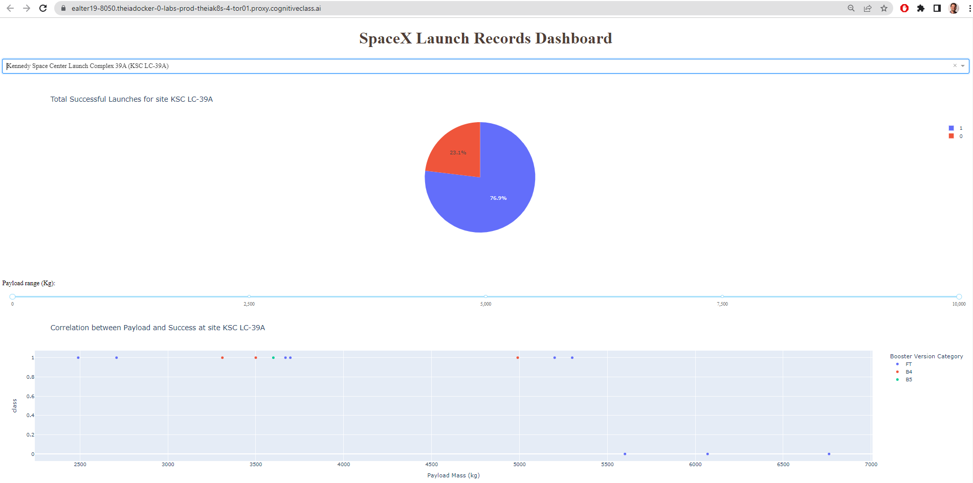
Build a Dashboard with Plotly Dash
The Dashboard includes the following:
Dropdown: Allows user to select Launch Site or all sites
Pie Chart: Displays percentage of successful launches vs failed launched for the selected launch site
Range Slider: Allows user to select payload mass (kg) range to view in chart. They can then observe changes among high/low mass payloads.
Scatter Plot: Allows user to see the correlation between Payload Mass, Launch Outcome (success or failure), and Booster Version.
GitHub URL of completed Plotly Dash lab
Notes:
Summarize what plots/graphs and interactions you have added to a dashboard
Explain why you added those plots and interactions
Add the GitHub URL of your completed Plotly Dash lab, as an external reference and peer-review purpose

Slide 16
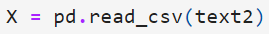
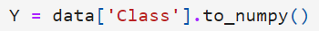
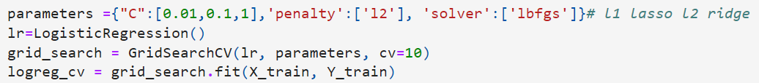
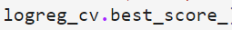
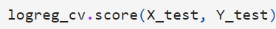
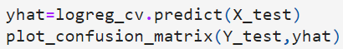
Predictive Analysis (Classification)
Predictive Analysis Methodology
Build
Preprocessing (Load dataframe, Standardize data)
Split data into Training and Testing sets
Set possible method parameters (varies by method: Logistic Regression, Support Vector Machine, Decision Tree Classifier, and K Nearest Neighbors). Define method, find best parameters using training data.
Evaluate
Identify best parameters, calculate accuracy (R2) based on training data
Calculating the accuracy (R2) for each method based on the testing data
Assess Confusion Matrices to determine what problems each method has
Determine the method that performs best
Flowchart example for Logistic Regression
Replace logreg_ with svm_, tree_, or knn for other methods and adjust parameters
GitHub URL of completed predictive analysis lab
Notes:
Summarize how you built, evaluated, improved, and found the best performing classification model
You need present your model development process using key phrases and flowchart
Add the GitHub URL of your completed predictive analysis lab, as an external reference and peer-review purpose

Slide 17
Results
Exploratory data analysis results
Interactive analytics demo in screenshots
Predictive analysis results

Slide 18

Section 2

Slide 19
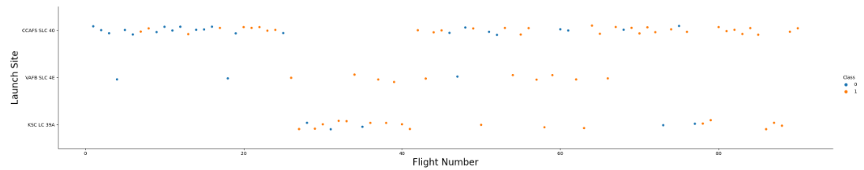
Flight Number vs. Launch Site
Show a scatter plot of Flight Number vs. Launch Site
For each Launch Site, there seems to be more successful launches as Flight Number increases
Notes:
Show a scatter plot of Flight Number vs. Launch Site
Show the screenshot of the scatter plot with explanations

Slide 20
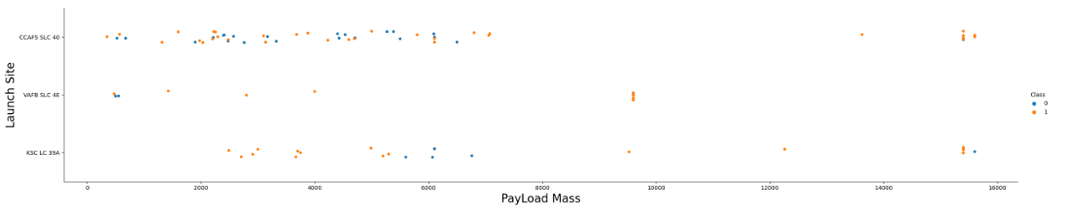
Payload vs. Launch Site
Show a scatter plot of Payload vs. Launch Site
For each Launch Site, there were more failures with lighter payloads, though heavier payloads may be more recent and have better success due to other learnings
Notes:
Show a scatter plot of Payload vs. Launch Site
Show the screenshot of the scatter plot with explanations

Slide 21
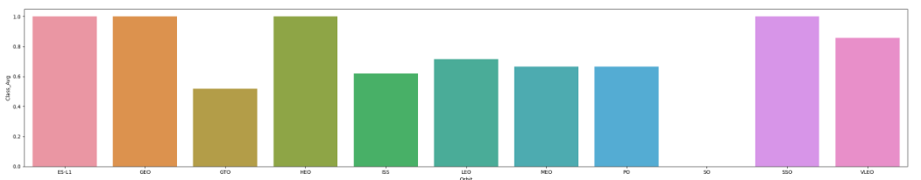
Success Rate vs. Orbit Type
Show a bar chart for the success rate of each orbit type
ES-L1, GEO, HEO, and SSO have the highest success rates

Slide 22
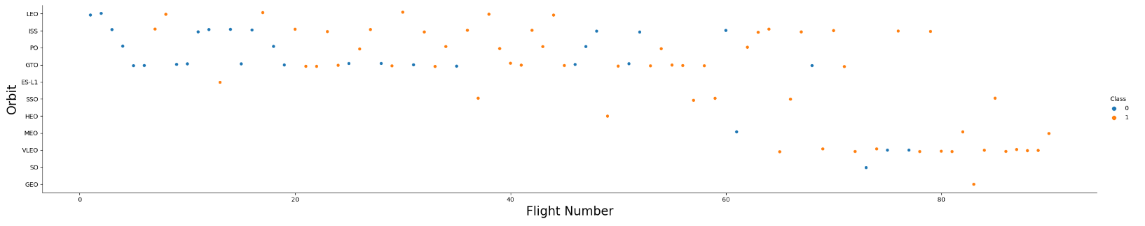
Flight Number vs. Orbit Type
Show a scatter point of Flight number vs. Orbit type
Success rates seem to improve for each Orbit type as Flight Number increases. This could be due to the SpaceX team learning more with each successive flight.

Slide 23
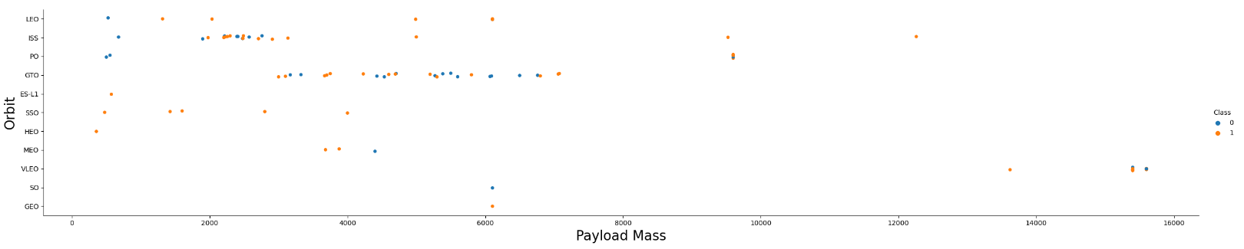
Payload vs. Orbit Type
Show a scatter point of payload vs. orbit type
For some orbits, lighter payloads have been correlated with more failures, but that could be attributed to other factors such as experience

Slide 24
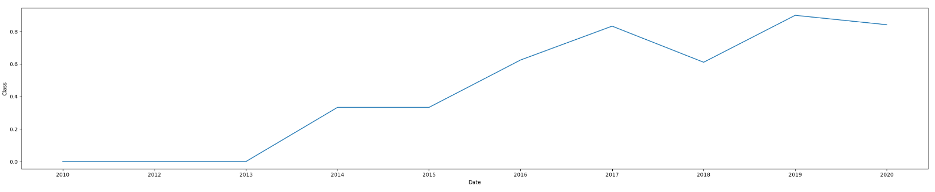
Launch Success Yearly Trend
Show a line chart of yearly average success rate
Success rate has been trending up from 2013-2020, and has reached 90% in 2019 and 84% in 2020.
Year | Avg Success Rate
2010 | 0%
2012 | 0%
2013 | 0%
2014 | 33%
2015 | 33%
2016 | 63%
2017 | 83%
2018 | 61%
2019 | 90%
2020 | 84%

Slide 25
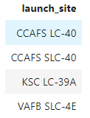
All Launch Site Names
SQL Query
Results
Explanation
Distinct returns unique names from the Launch_Site column of the SpaceXTable
Notes:
Find the names of the unique launch sites
Present your query result with a short explanation here

Slide 26
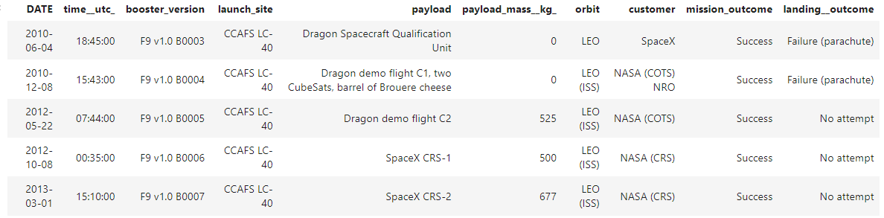
Launch Site Names Begin with 'CCA'
SQL Query
Results
Explanation
The asterisk selects all entries that meet the rest of the criteria. “where” and “like” ‘CCA%’ filters entries that being with ‘CCA’ in LAUNCH_SITE. The ‘%’ indicates anything may follow. “limit 5’ selects only the first 5 entries.
Notes:
Find 5 records where launch sites begin with `CCA`
Present your query result with a short explanation here

Slide 27
Total Payload Mass
SQL Query
Results
Explanation
This sums all payload masses where the customer is NASA (CRS)
Notes:
Calculate the total payload carried by boosters from NASA
Present your query result with a short explanation here

Slide 28
Average Payload Mass by F9 v1.1
SQL Query
Results
Explanation
This averages payload mass for the specific booster version indicated
Notes:
Calculate the average payload mass carried by booster version F9 v1.1
Present your query result with a short explanation here

Slide 29
First Successful Ground Landing Date
SQL Query
Results
Explanation
Returns earliest date Ground Pad has success
Notes:
Find the dates of the first successful landing outcome on ground pad
Present your query result with a short explanation here

Slide 30
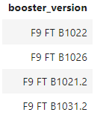
Successful Drone Ship Landing with Payload between 4000 and 6000
SQL Query
Results
Explanation
The “where” and “and” terms filter the returns. The “between” term filters to values between 4000 and 6000.
Notes:
List the names of boosters which have successfully landed on drone ship and had payload mass greater than 4000 but less than 6000
Present your query result with a short explanation here

Slide 31
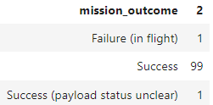
Total Number of Successful and Failure Mission Outcomes
SQL Query
Results
Explanation
Returns the count of each possible mission outcome
Notes:
Calculate the total number of successful and failure mission outcomes
Present your query result with a short explanation here

Slide 32
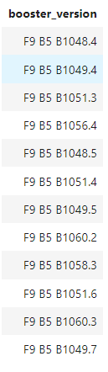
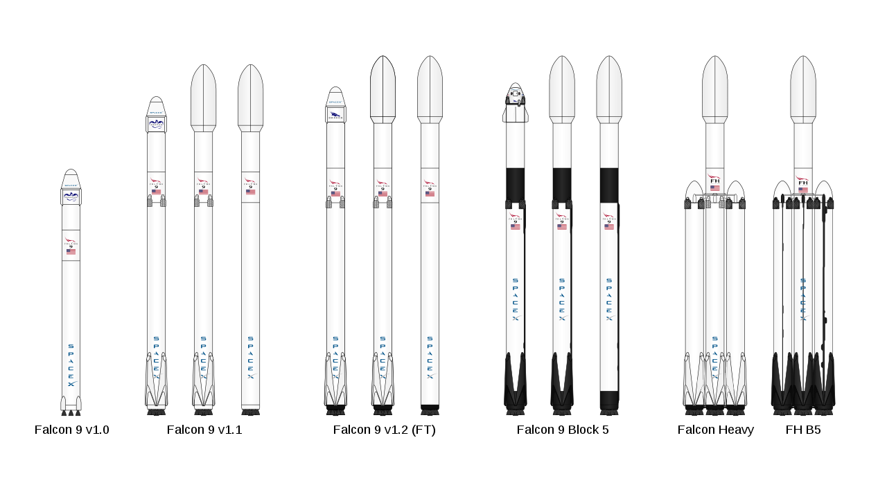
Boosters Carried Maximum Payload
SQL Query
Results
Explanation
“max” term finds the highest payload mass. Parenthesis show subquery. Max Payload is 15600kg and 12 booster versions carried that weight.
Notes:
List the names of the booster which have carried the maximum payload mass
Present your query result with a short explanation here

Slide 33
2015 Launch Records
SQL Query
Results
Explanation
Returns failed landing outcomes for the Drove Ship in 2015 only
Notes:
List the failed landing_outcomes in drone ship, their booster versions, and launch site names for in year 2015
Present your query result with a short explanation here

Slide 34
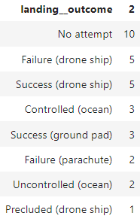
Rank Landing Outcomes Between 2010-06-04 and 2017-03-20
SQL Query
Results
%sql select landing__outcome, count(landing__outcome) from SPACEXTABLE where (date between '2010-06-04' and '2017-03-20') group by landing__outcome order by count(landing__outcome) desc;
Explanation
The “Group By” term groups results by landing outcome, “date between” selects dates between the two input dates, “order by” count orders them by count in descending order.
Notes:
Rank the count of landing outcomes (such as Failure (drone ship) or Success (ground pad)) between the date 2010-06-04 and 2017-03-20, in descending order
Present your query result with a short explanation here

Slide 35

Section 3

Slide 36
Folium Map of Launch Sites
This map shows all launch sites in circles, and clusters together those that are in close proximity with one another
Notes:
Replace <Folium map screenshot 1> title with an appropriate title
Explore the generated folium map and make a proper screenshot to include all launch sites’ location markers on a global map
Explain the important elements and findings on the screenshot

Slide 37
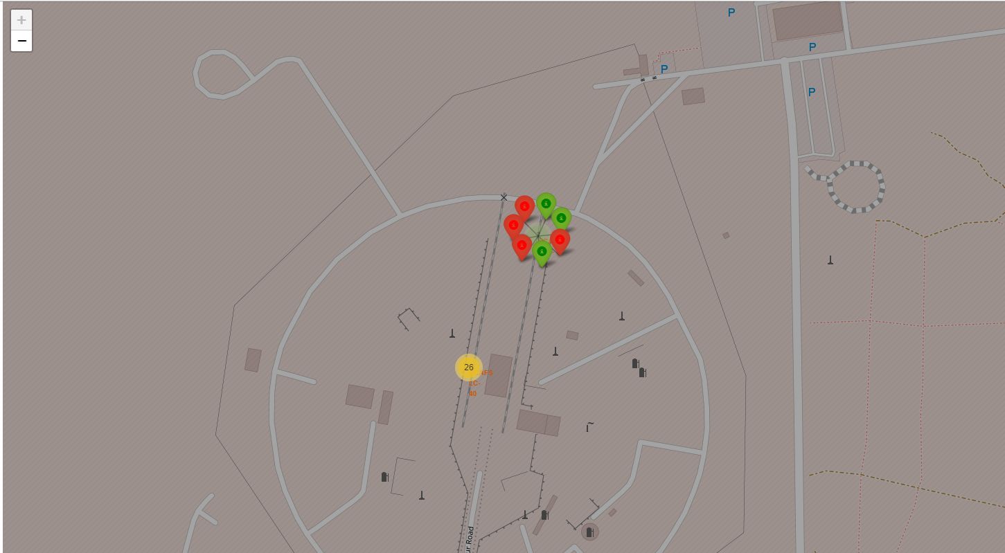
Folium Map Marker Clusters
This map is zoomed in on the Cape Canaveral Launch Sites. The yellow circle with “26” indicates that 26 launches happened at that spot0, and are clustered together for ease of viewing. To the north east of that circle there was a yellow circle marked with a “7”, indicating that 7 launches happened at that spot. In the screenshot above, I’ve clicked on that circle to reveal the 7 individual launches as their own markers. Each marker is colored either green for success or red for failure.
Notes:
Replace <Folium map screenshot 2> title with an appropriate title
Explore the folium map and make a proper screenshot to show the color-labeled launch outcomes on the map
Explain the important elements and findings on the screenshot

Slide 38
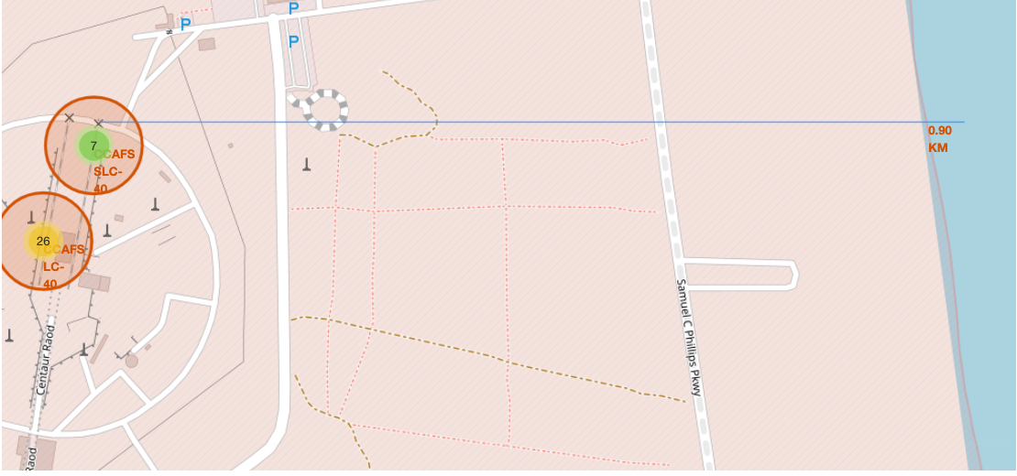
Folium Map Distances
This screenshot show two clusters of launches on the left, and a blue line shows the distance between the CCAFS SLC-40 site and the coast, and indicates that it is 0.90 KM away.
Notes:
Replace <Folium map screenshot 3> title with an appropriate title
Explore the generated folium map and show the screenshot of a selected launch site to its proximities such as railway, highway, coastline, with distance calculated and displayed
Explain the important elements and findings on the screenshot

Slide 39

Section 4

Slide 40
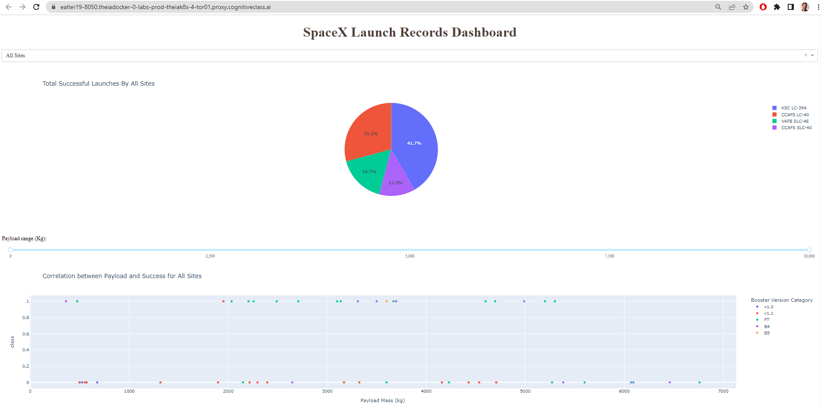
Successful Launches by Launch Site in Dashboard
In this dashboard, the dropdown is filtered to “All Sites” and the Pie Chart is showing the breakdown of successful launches across the 4 Launch Sites, for the entire Payload Range. The drop down can be used to select specific sites and show each sites success rate in the pie chart.
Notes:
Replace <Dashboard screenshot 1> title with an appropriate title
Show the screenshot of launch success count for all sites, in a piechart
Explain the important elements and findings on the screenshot

Slide 41
KSC LC-39A has the highest success rate
Kennedy Space Center Launch Complex 39A (KSC LC-39A) had a success rate of 76.9%, which is higher than any other launch site measured in this analysis. The drop down is filtered to KSC LC-39A and the pie chart shows success and failure (success = 1, failure = 0).
Notes:
Replace <Dashboard screenshot 2> title with an appropriate title
Show the screenshot of the piechart for the launch site with highest launch success ratio
Explain the important elements and findings on the screenshot

Slide 42
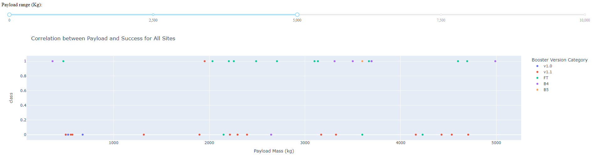
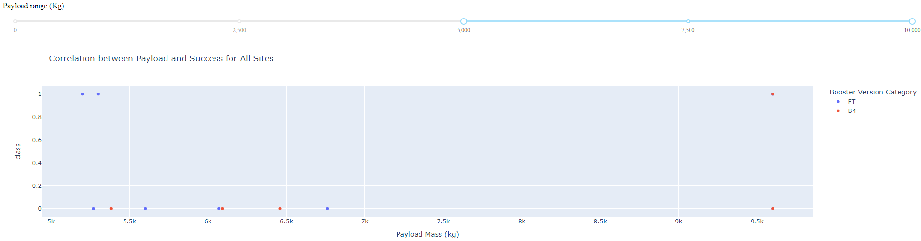
Payload vs Launch Outcomes for all sites
Light Payload (0 - 5000 kg)
Heavy Payload (5000 – 10000 kg)
The top chart uses the range slider to show payload mass 0-5000 kg for all booster types (color coded in legend). Successful flights are shown at 1, and failures at 0 on the y axix. The bottom chart show the same but for 5000-1000 kg. For lighter payloads, FT seems to have a very high success rate, while v1.1 has a low success rate. For heavy payloads, both booster types have low success rates.
Notes:
Replace <Dashboard screenshot 3> title with an appropriate title
Show screenshots of Payload vs. Launch Outcome scatter plot for all sites, with different payload selected in the range slider
Explain the important elements and findings on the screenshot, such as which payload range or booster version have the largest success rate, etc.

Slide 43

Section 5

Slide 44
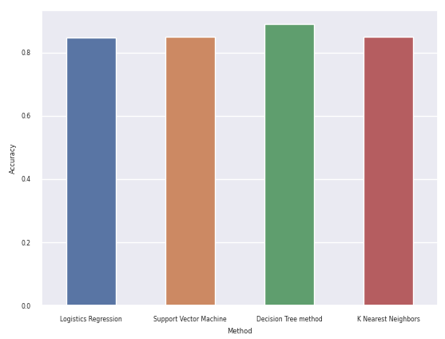
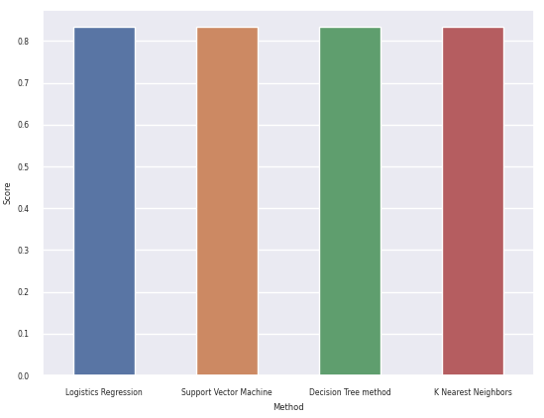
Classification Accuracy
Training Accuracy across Methods
Testing Accuracy across Methods
The Decision Tree method had the highest accuracy when training the model. It had an AccuracyR2 of 89%, while the other 3 models had an Accuracy/R2 of 85%. All 4 models had the same Accuracy/R2 in the testing phase of 83%.
Notes:
Visualize the built model accuracy for all built classification models, in a bar chart
Find which model has the highest classification accuracy:

Slide 45
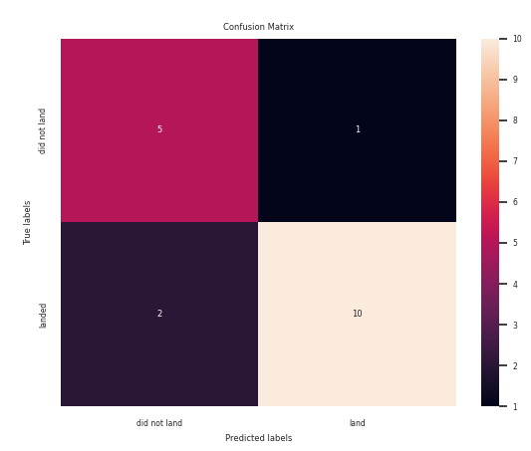

Confusion Matrix
The Decision Tree Method is good at detecting True Positives in the lower right quadrant and True Negatives in the upper left quadrant. However, it has problems because it did register a small number of False Positives in the upper right quadrant and False Negatives in the lower left quadrant.
Notes:
Show the confusion matrix of the best performing model with an explanation

Slide 46
Conclusions
The Decision Tree method is the best option for predicting success rates. It had an R2 score of 89% in training and 83% in testing. The 3 other methods (Logistic Regression, Support Vector Machine, and K Nearest Neighbor) all performed similarly with a training R2 of 85% and testing R2 of 83%.
The Kennedy Space Center Launch Complex 39A (KSC LC-39A) is the launch site with the highest success rate by far (76.9%). Cape Canaveral Launch Complex 40 (CAFS LC-40) has the lowest success rate (26.9%).
Vandenberg Air Force Base Space Launch Complex (VAFB SLC-4E) (42.9%) and Cape Canaveral Space Launch Complex 40 (CCAFS SLC-40 (40.0%) are similar in success rates (42.9% and 40.0% respectively).
Heavy Payloads (>5,000kgs) have a low success rate at 35.7% compared to Lighter Payloads (<5,000kg) at 45.2%.
Booster Version FT has a high success rate (66.7%). Booster Versions v1.0 and v1.1 had very low success rates (5.0% combined). B4 and B5 combined had a 58.3% success rate.
SpaceX Falcon 9 Success Rates improve each year as their team learns new lessons. Their success rate reached up to 90% in 2019 and 84% in 2020.
KSC LC-39A and VAFB SLC-4E have had more success with heavy payloads (>5000kg) than CCAFS LC-40 and CCAFS SLC-40.
The orbits ES-L1, GEO, HEO, and SSO have the highest success rates
The success rate of landing on a drone ship (74%) is similar to landing on a ground pad (75%)

Slide 47
Appendix
GitHub Repository Link: https://github.com/ealter19/Applied-Data-Science-Capstone
Applied your creativity to improve the presentation beyond the template
Displayed additional graphics to help reader understand rockets
Displayed any innovative insights
Performed extra EDA analysis: The success rate of landing on a drone ship (74%) is similar to landing on a ground pad (75%)

Slide 48


